Slide 1
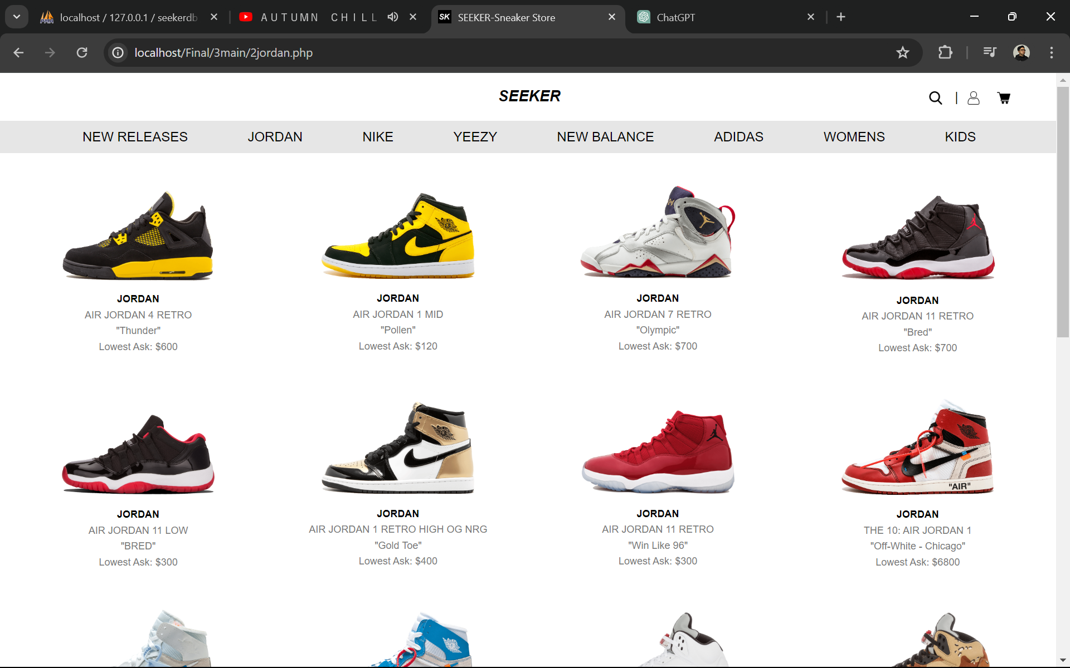

SEEKER
Sneaker Online Store
PROJECT PRESENTATION

Slide 2
List of Contents
1 | About the Company
2 | Our Mission and Vision
3 | Our Goals
4 | Project Overview
5 | Stakeholder Analysis
7 | Project Timeline
8 | Project Budget
9 | Innovative Features
10 | Constraints and Obstacles
11 | Website Demonstration

Slide 3

About the Company
Founded in 2023: Providing an extensive selection of 100% authentic sneakers, including limited-edition releases, collaborations, classics, and performance footwear.
Stylish and Sustainable: We sell sneakers that look great and are good for the planet.
Community and Engagement: Building a vibrant sneaker community through a dedicated blog, social media engagement, artist collaborations, and charity initiatives.
Commitment to Growth and Sustainability: Focused on international expansion, opening physical showrooms, and partnering with eco-friendly brands to promote sustainable practices.
SEEKER

Slide 4
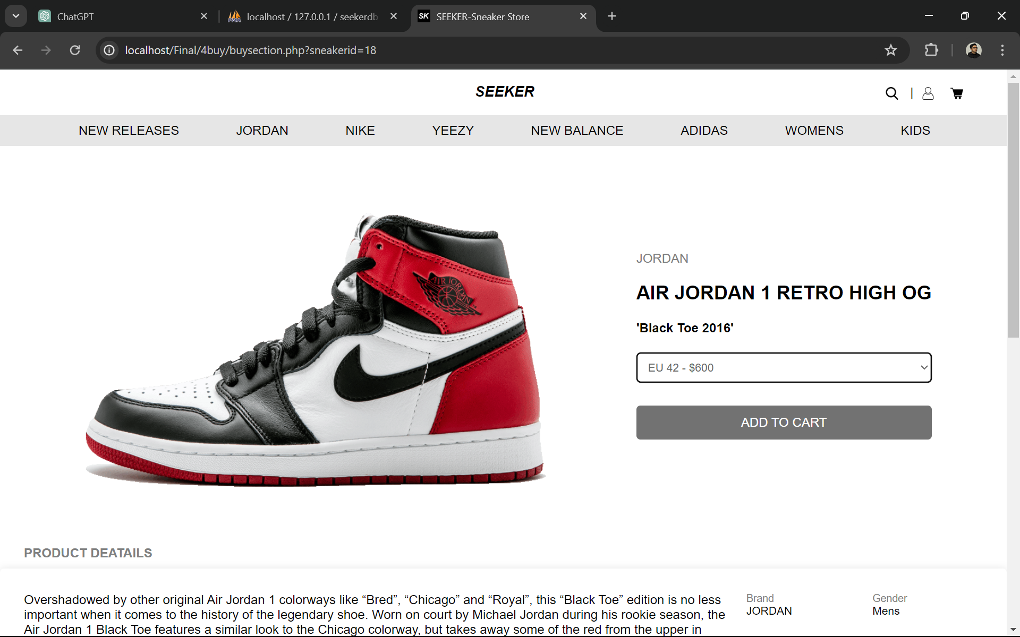
Our Mission and Vision
Mission
Vision
Customer Satisfaction: Exceptional service and high-quality, authentic sneakers.
Accessibility: Latest sneakers available to everyone.
Community Building: Engaged community of sneaker enthusiasts.
Market Leadership: Leading online destination for sneaker enthusiasts.
Innovation: Revolutionize online sneaker shopping with cutting-edge technology.
Sustainability: Promote sustainable practices and support eco-friendly brands.
SEEKER

Slide 5




Our Goals
Goal # 1
Goal # 2
Goal # 3
Expand into New Markets
Collaborate with Influencers
Expand the Sneaker Community
SEEKER

Slide 6
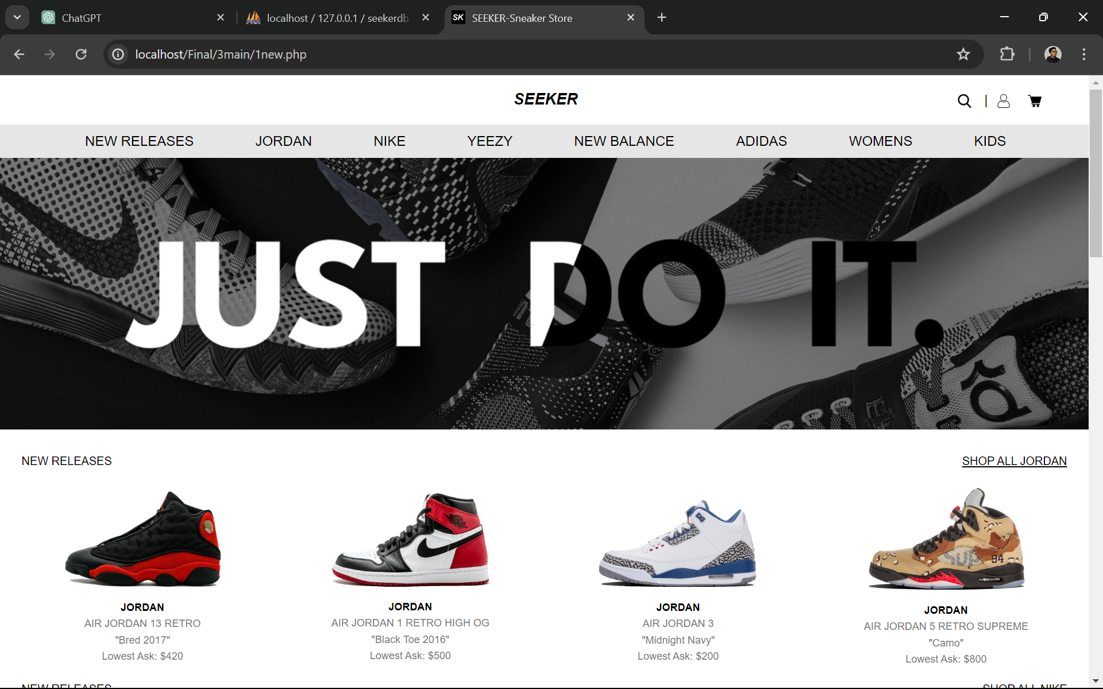
Project Overview
Designing, developing, and launching an e-commerce platform dedicated to sneaker sales.
Providing an intuitive and visually appealing interface for seamless browsing and purchasing.
Ensuring compatibility across desktop and mobile devices for convenient access.

Slide 7

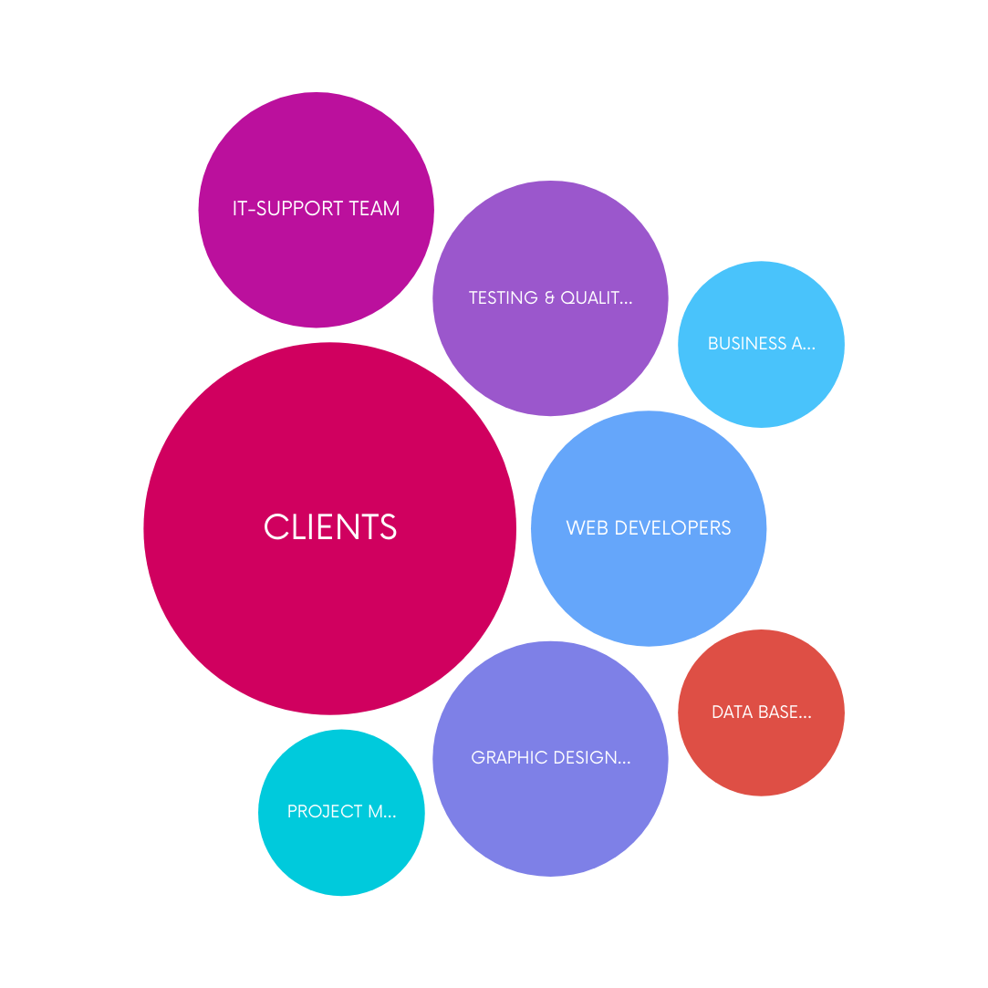
STAKEHOLDERS ANALYSIS
SEEKER WEB DEVELOPMENT

Slide 8
PROJECT TIMELINE - SHORT TERM PROJECT - AGILE SPRINT
1 week
Start from 1.4.2024
1 week
3 weeks
PHASE 1
PHASE 2
PHASE 3
Research and Planning
Designing Database
Website Development
PHASE 4
PHASE 5
Testing and Quality Assurance
Project Finalization
1 week
1 week
End in 19.5.2024

Slide 9
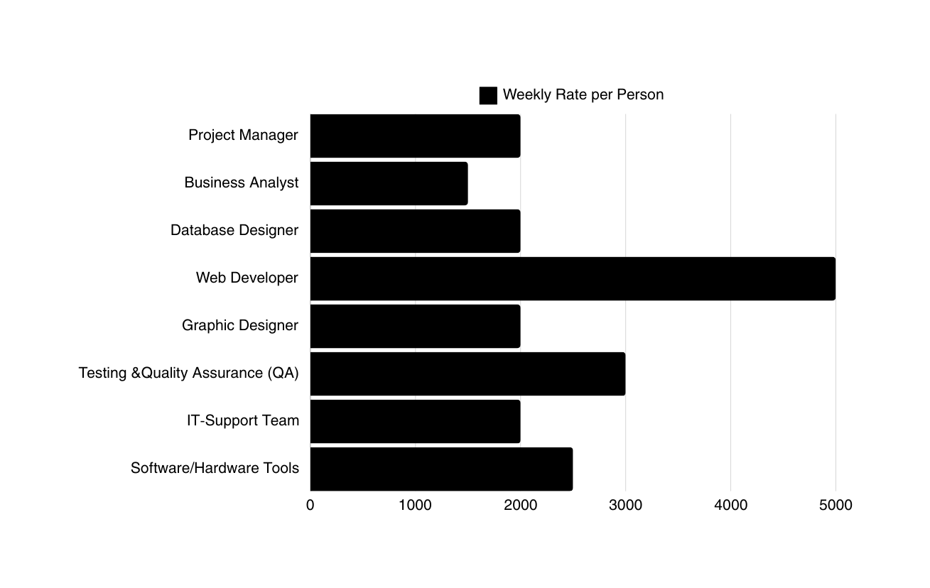
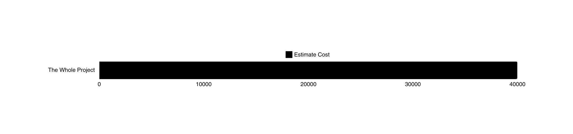
BUDGET
SUMMARY
In short-term projects, the choice of payment method is crucial for ensuring fairness, transparency, and project success. One effective approach is employing a weekly rate per person payment model, which offers several advantages for both stakeholders and project managers.
$
$
$
$
$
$
$
$
$
$
$
SEEKER

Slide 10

Innovative Features
Innovative Features
FEATURES FOR CUSTOMERS
FEATURES FOR ADMINISTRATORS
Role management for efficient task delegation
INNOVATIVE FEATURES
Secure login and signup
Secure password with security questions
Sneaker inventory management: insert, update, delete
Browse sneakers with detailed information
Review and respond to customer feedback
Add to cart for easy checkout
Order management: view and edit order statuses
Seamless purchase process
Payment tracking for financial oversight
Several Payment Options
Customer management: update customer block status

Slide 11

1 | Technical challenges: Developing and maintaining a robust e-commerce website requires expertise in various technologies and platforms.
2 | Competition: The sneaker market is highly competitive, requiring effective differentiation strategies to stand out.
3 | Logistics and supply chain management: Ensuring timely delivery of orders and managing inventory levels can pose logistical challenges.
4 | Security concerns: Protecting customer data and ensuring secure transactions are essential to building trust and credibility.
Constraints &
Obstacles

Slide 12

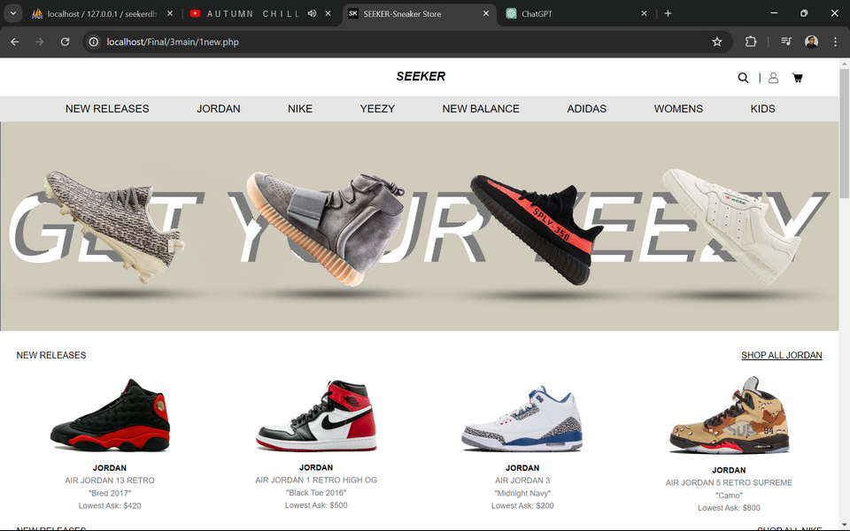

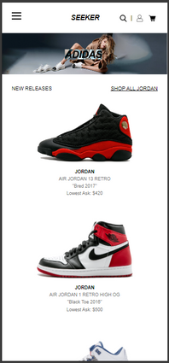

DESKTOP | LAPTOP | MOBILE
SEEKER
Sneaker Online Store
WEBSITE DEMONSTRATION

